Slide 1
Ariba Network Commerce Automation User Manual
Search for PO

Slide 2
Objective
The goal of this user manual is to:
Understand the process of how supplier can search for PO on Ariba Network
Target Audience:
Supplier User
Course Pre-requisites:

Slide 3
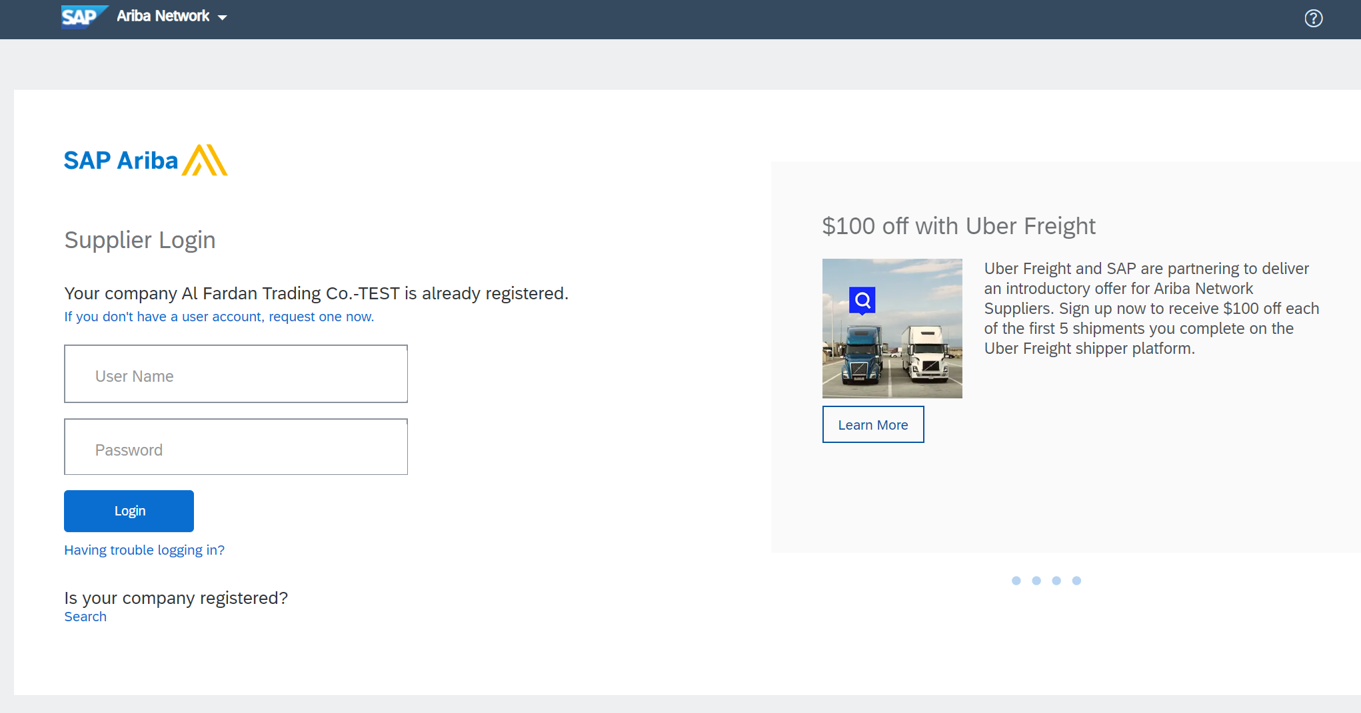
Search for PO
Go to supplier.ariba.com
1. Enter your existing Username and Password
2. Click “Login” button

Slide 4
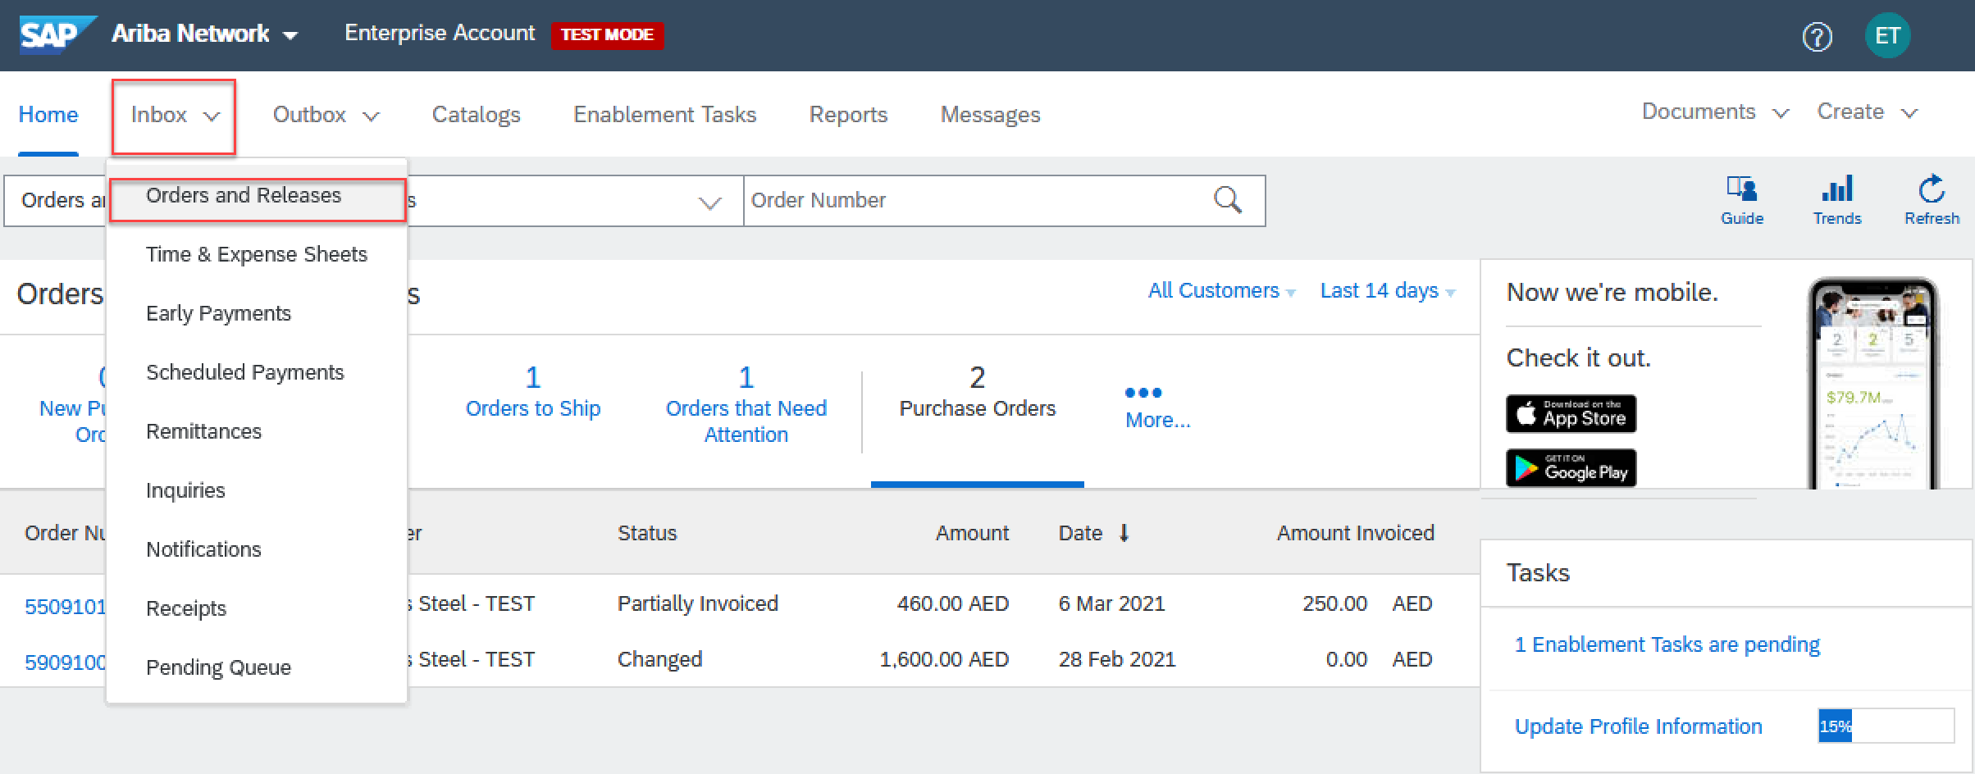
Search for PO (Enterprise Account)
3. Press on “Inbox”
4. Click “Orders and Releases” button

Slide 5
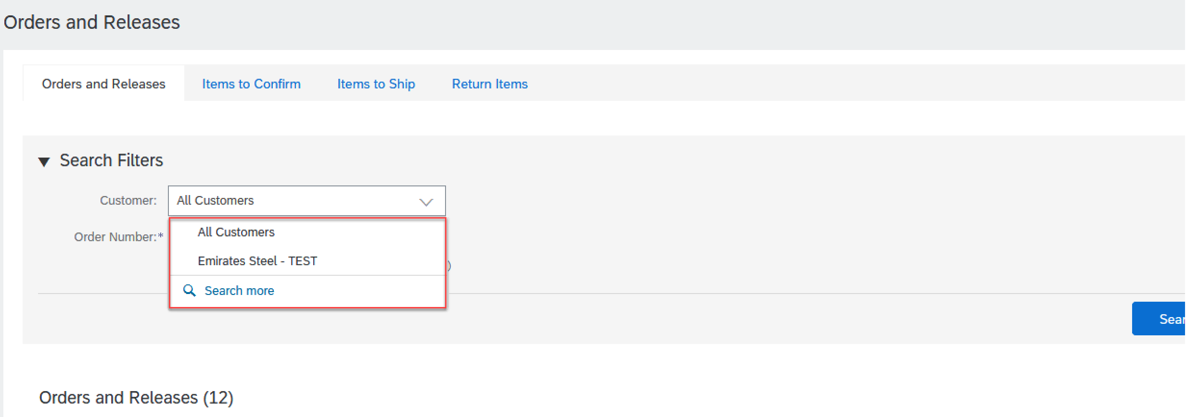
Search for PO (Enterprise Account)
5. 1s way, Supplier can search by customer where he will click on customer then choose from drop down list which customer he wants to process his order

Slide 6
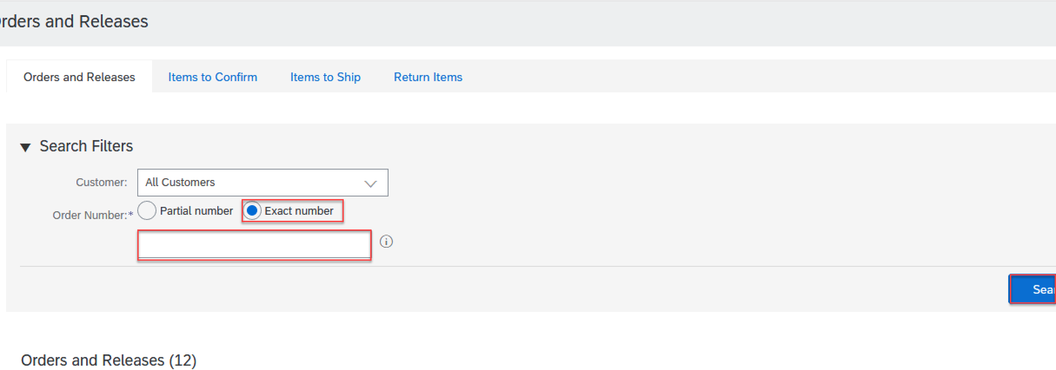
Search for PO (Enterprise Account)
6. 2nd way, using exact number where supplier can search for the PO by choosing exact number and then enter PO and then press search

Slide 7
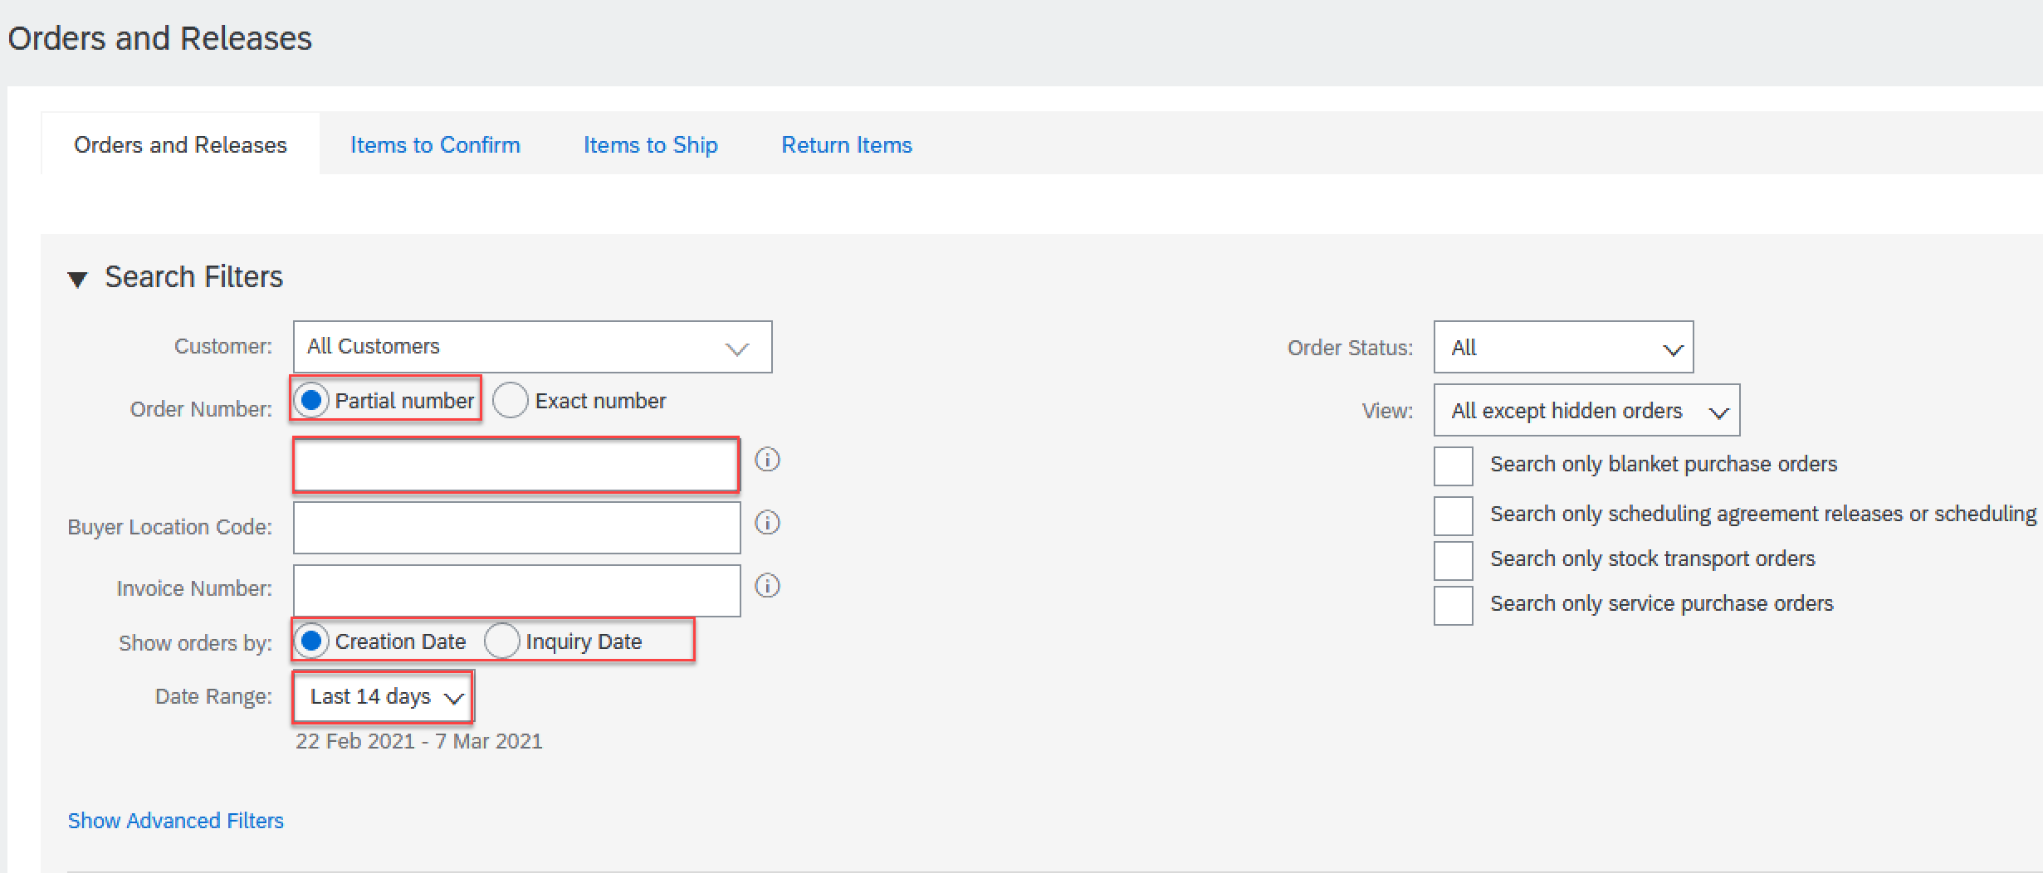
Search for PO (Enterprise Account)
7. 3rd way, using partial number where supplier can search for the PO by choosing partial number and then enter part of the PO or supplier can search by creation date

Slide 8
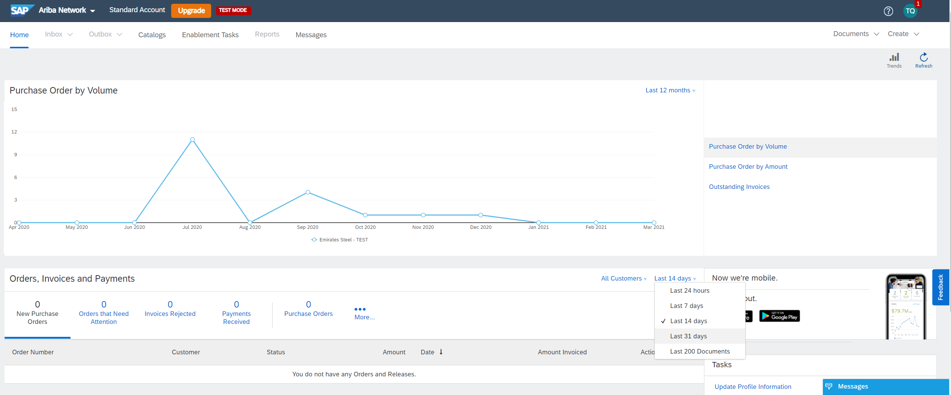
Search for PO (Standard Account)
8. Press on “Last 14 days” then press on “Last 200 documents”

Slide 9
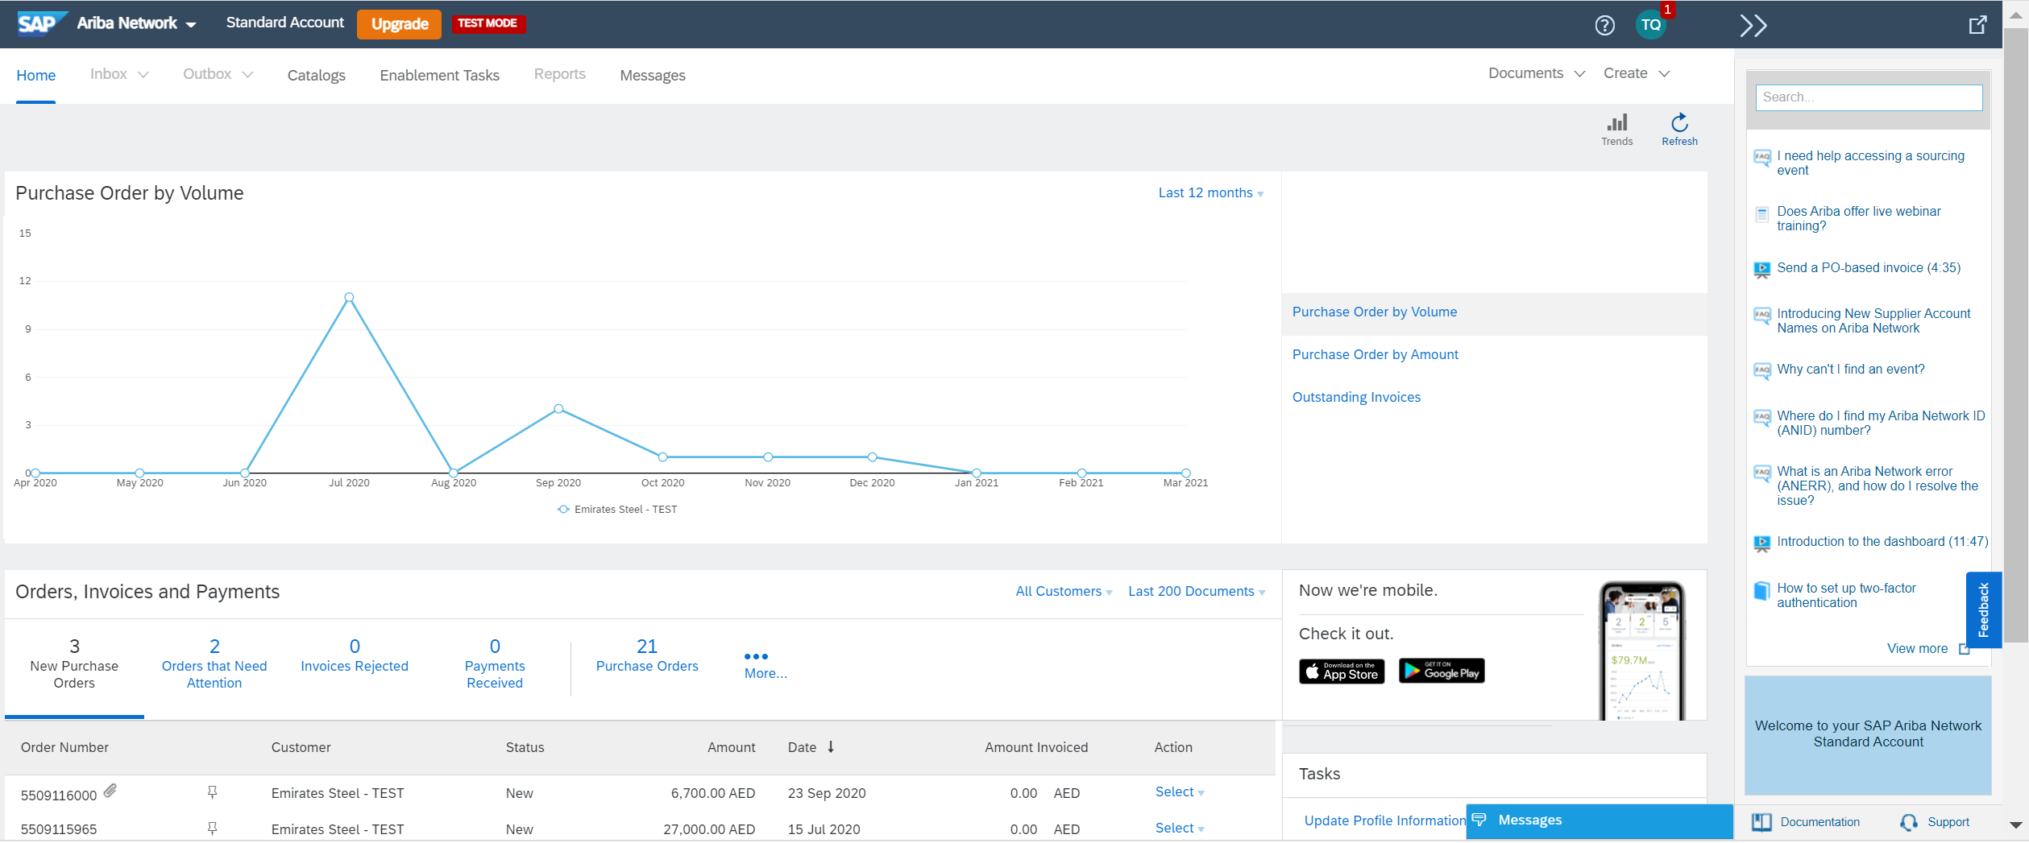
Search for PO (Standard Account)
9. Press on “Purchase Orders” and a list last 200 orders will appear

Slide 10
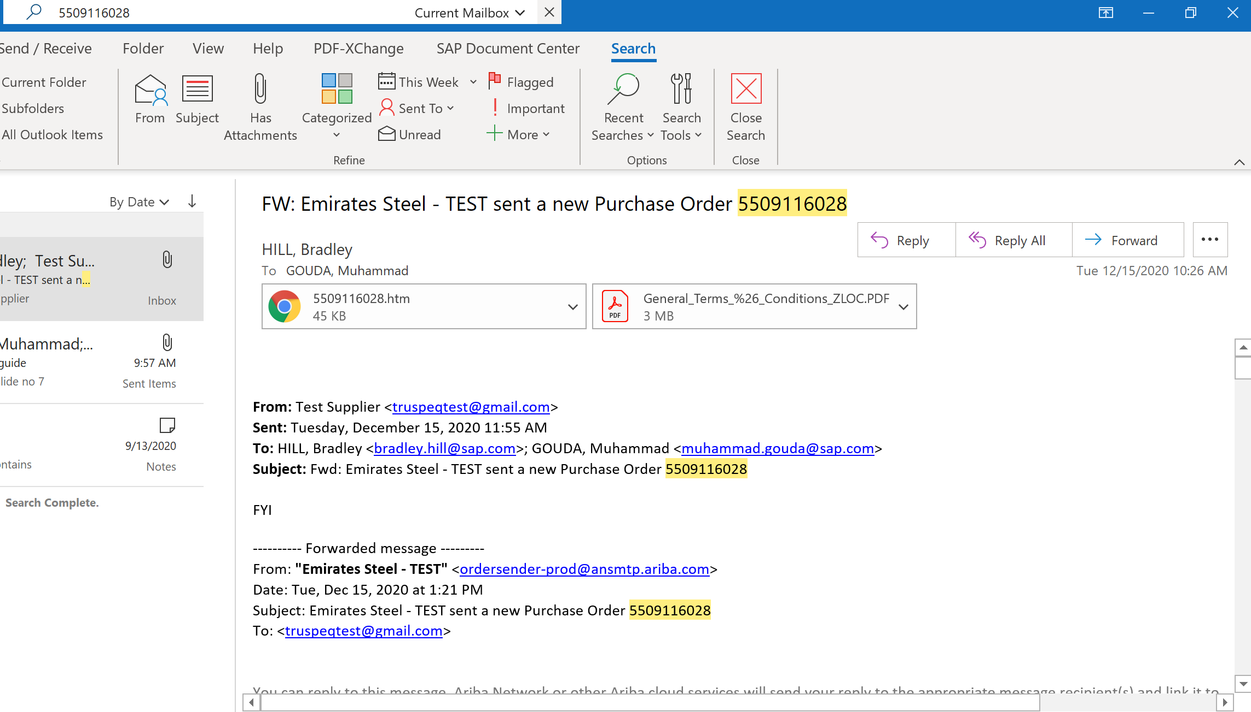
Search for PO (Standard Account)
10. For standard account suppliers, they can also search for the PO in their inbox if they remember the PO number

Slide 11
Thank You

